Slide 1

ggPMX Efficient and Versatile R package for Pharmacometrics Model Diagnostic Plots
Irina Baltcheva, Bruno Bieth, Matt Fiddler, Souvik Bhattacharya
Notes:
IB – Bruno and I will present today on behalf of the ggPMX team, currently composed of both of us, Andrzej, Matt and Souvik from Novartis. ggPMX is an open-source R package which we developed over the past years with the aim to provide to the Pharmacometrics community a model diagnostics toolbox that is efficient and versatile.

Slide 2


Life before ggPMX
Life with ggPMX
Notes:
BB- If you wonder of the value of another R package in addition to all the R package you use in your daily workflow, we thought with Irina that we would need to capture your reaction whenever you need to write your piece of codes for generating diagnostic plot. This is what you have on the left hand side. No matter how comfortable you are with R, from time to time, you will have to figure out where is the bug in your piece of code or you have to deal with the frustration of spending more time than planned on writing the codes.
The good news we have for you is that when you start using ggPMX, it is like having the gift from an Angel. It would save you tremendous amount of time in writing those line of codes

Slide 3

Compatible with NONMEM, Monolix, and nlmixr
Consistent, reproducible and efficient workflow
Automated generation of PDF, Word or PNG outputs for reporting purpose
Advanced Features for customization and stratification
High quality graphics, ready-to-use in submission documents and publications
Notes:
IB – And the beauty of ggPMX is that it is compatible with three of the most used non-linear mixed effect model fitting software, namely NONMEM, Monolix and nlmixr.
Actually, it all started with the internal Model building guidance that we developed at Novarits. We realized that we have a gap in our workflow, because each of us has his/her own code for diagnostic plots and this creates inefficiencies in terms of validation. We therefore designed the package having in mind its cross-software compatibility and consistency.
A key feature of ggPMX is the automated generation of a diagnostics report. We also allowed for a lot of flexibility in terms of customization options. Finally, an important feature is the possibility to use it in for submission work or publications.

Slide 4
List of Diagnostic Plots
Section of modeling report | Description | HA
Main body | Normalized prediction distribution errors versus population predictions (NPD vs. EPRED) | ✔
 | Normalized prediction discrepancies versus time (NPD vs. TIME) | ✔
 | Individual weighted residuals versus individual predictions (IWRES vs. IPRED) | ✔
 | Individual weighted residuals versus time (IWRES vs. TIME) | ✔
 | Visual predictive check (VPC) | ✔
Appendix | Distribution and quantile-quantile plot of IWRES | ✔
 | Distribution and correlation structure of estimated inter-individual random effects (ETA) | ✔
 | Relationships between estimated inter-individual random effects (ETA) and covariates | ✔
 | Observations and model predictions per individual (individual fits) | ✔
 | Observations versus population predictions (DV vs. EPRED) | ✔
 | Observations versus individual predictions (DV vs. IPRED) | ✔
 | Absolute individual weighted residuals versus individual predictions (|IWRES| vs. IPRED) | ✔
Notes:
IB – When we think of diagnostics plots, we all know that to assess the robustness of your model, you need to rely on a wide range of figures, such as NPD vs EPRED, NPD vs TIME, etc. Ultimately, you’ll need to generate a long list of plots for each model, coming with several lines of code.
Here is an extract of the model building guidance, from the section on modeling report: This suggests where to place the different plots, either in the main body or the appendix of the modeling report. It should not be seen as a strict rule; we want to emphasize content (i.e. the overall package of diagnostics that we consider essential for model evaluation) rather than where they should go in the report.

Slide 5
ggPMX Architecture
Object-oriented
Reader
Reads model outputs from modeling software
Restructures them into standard format for internal processing
Generator
Processes outputs from Reader by generating diagnostic plots
Controller
Serves as user interface to ggPMX object
The user will call Generator functions via wrapper functions in the Controller to produce either all the default plots or selected plots of interest
User can edit the configuration and customize plots
Reporter
Generates graphs and tables into an output file (Word or PDF) with annotations

Slide 6
ggPMX - Intuitive & Fast Comprehensive model diagnostics report with two lines of code
library(ggPMX)
Controller Creation
ctr <- pmx_nm(directory = nonmem_dir_path,
file = “my_nonmem_run.lst")
NONMEM
ctr <- pmx_mlxtran(file_name = mlxtran_path)
Monolix
ctr <- pmx_nlmxir(fit)
nlmixr
Report Generation
ctr %>% pmx_report(name = "ggPMX_Report",
save_dir = "working_directory",
format = "report", extension = "word")
Notes:
BB – with ggPMX, you’ll be asked to only type two lines of code to generate the extensive list of diagnostic plots you have seen previously! First need to create a ggPMX controller, an object containing all required information to generate the figure. Done in different manner depending of the modeling software: NONMEM: on the control file, Monolix, on the mlxtran file, nlmixr on a object produced by nlmixr fiiting. After that, need to execute the generate a document listing all plots using pmx_report

Slide 7
Controller Options
Parameter name | Meaning
sys | name of the software used for model fitting (“mlx”)
config | path to configuration file, name of configuration within the built-in list of configurations, or a configuration object
directory | path to directory containing fit results
input | path to modeling dataset (used for model fitting)
dv | name of column in modeling dataset that defines the dependent variable
id | name of column in modeling dataset that defines the subject identifier
time | name of column in modeling dataset that defines the independent (usually time) variable
dvid | name of column in modeling dataset that defines the identifier of the dependent variable (mandatory in case of multiple endpoint)
cats | vector of categorical covariates (as in modeling dataset)
conts | vector of categorical covariates (as in modeling dataset)
strats | vector of stratification variables (as in modeling dataset)
occ | name of dataset column for inter-occasion variability
settings | graphical settings shared by all plots
endpoint | defines the endpoint for which to display diagnostics
sim | user-provided simulations for VPC plot
bloq | defines settings of censored data
mandatory
character
optional
object

Slide 8
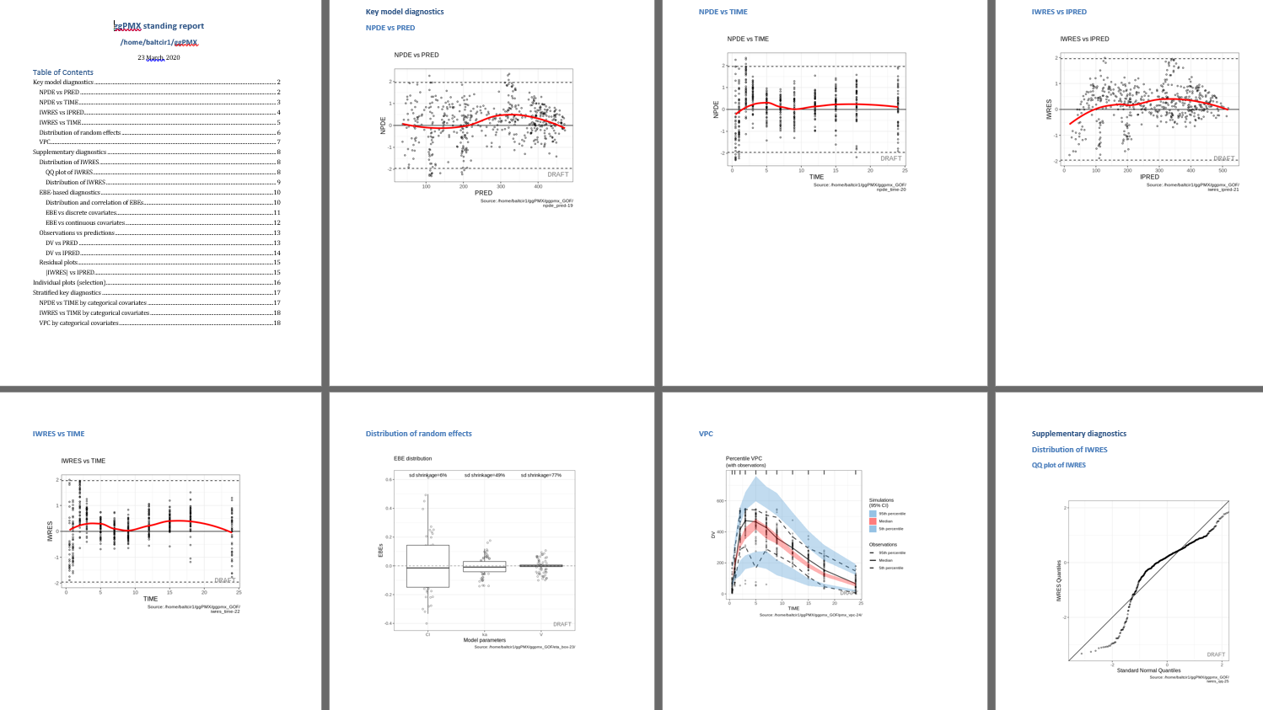
Notes:
BB – As an example, we have done a screen shot of the report for you... Word document with table of content – one figure per page, NPDE vs time, distribution of RE. VPC

Slide 9
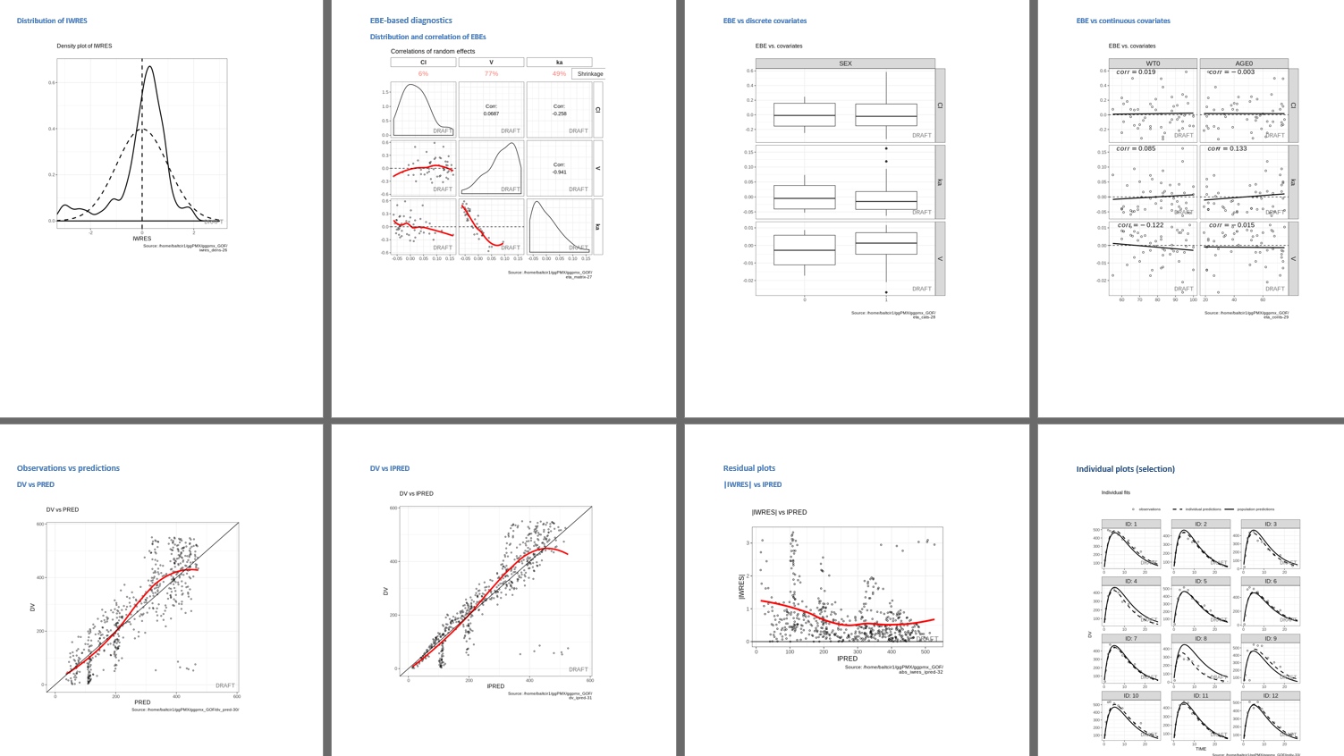
Notes:
BB - Correlation of random effect, distribution of RE according to categorical or continuous covariates, individual fits

Slide 10
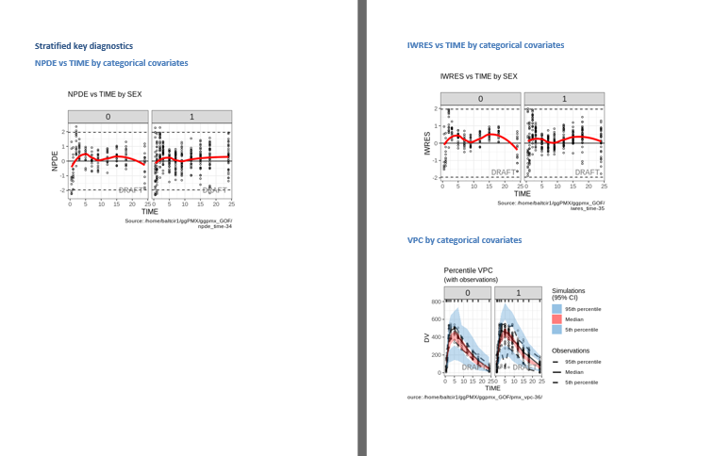
Notes:
BB- last page contained all additional stratifical you have identified deemed necessary in evaluation the robustness of your model building

Slide 11
Software-Specific Requirements
NONMEM
Version ≥ 7.2
Same output table setting as xpose
Monolix
Version ≥ 2016
Run at least the following Monolix tasks:
Population Parameters
EBEs
Standard errors
Plots
Export Chart data
Select at least the following plots to be displayed and saved:
individual fits and
scatter plot of the residuals
nlmixr/nlmxir2
nlmixr > 2.0 for censoring support
nlmixr output object
turn on/off generation of a VPC when creating the ggPMX controller
Notes:
BB– Because this library has been developed over the past years, there are some requirements in terms of modeling software versions. : you need to use version later than 7.2 in NONMEM. For Monolix version later than 2016 and perform some specific tasks to retrieve the data related to diagnostics plots

Slide 12
How to create a controller?
library(ggPMX)
library(nlmixr)
one.compartment <- function() { ini({ tka <- 0.45 # Log Ka tcl <- 1 # Log Cl tv <- 3.45 # Log V eta.ka ~ 0.6 eta.cl ~ 0.3 eta.v ~ 0.1 add.sd <- 0.7 }) model({ ka <- exp(tka + eta.ka) cl <- exp(tcl + eta.cl) v <- exp(tv + eta.v) d/dt(depot) = -ka * depot d/dt(center) = ka * depot - cl / v * center cp = center / v cp ~ add(add.sd) }) }
fit <- nlmixr(one.compartment, data, est= "saem" ,control=list(print=0))
saveRDS(fit,"fit.rds")
ctr = pmx_nlmxir(fit, vpc= FALSE)
ctr %>% pmx_report("nlmixr_report",".")
#Define the one compartmental model for nlmixr
#Use nlmixr to estimate the parameters of the one compartmental model
#Create the controller function

Slide 13
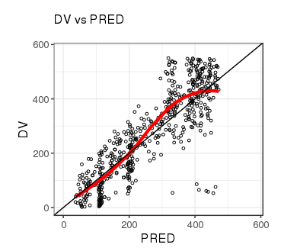
Default diagnostic plots
Plots visualized using the functions pmx_plot_xx(), where xx is a placeholder for the plot name. First argument is always the controller (use piping!)
List of plot names available by printing the controller or by calling the function plot_names()
Example:
ctr %>% pmx_plot_dv_pred()
ctr %>% pmx_plot_npde_time()
ctr %>% pmx_plot_eta_box()
ctr %>% pmx_plot_eta_matrix()
ctr %>% pmx_plot_individual()
ctr %>% pmx_plot_vpc()
Notes:
IB- you can generate report. And a report is nothing but a series of single plot commands. We have given an example here. You use the controller to call the single plot functions using the syntax pmx_plot_nameoftheplot(). A list of all available graphs can be seen by calling plot_names().

Slide 14
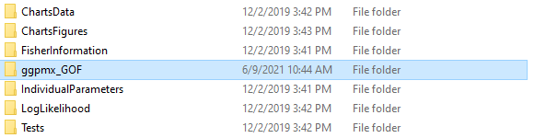
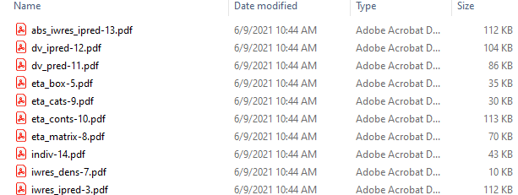
Generating a Diagnostics Report: pmx_report()
3 report formats available (Word, pdf, html) – by default, Word document (only) is generated
Possibility to create a folder containing all figures, saved as individual files
ctr %>% pmx_report( name = "Report_ggPMX", # Report Filename
save_dir = "work_dir", # Directory Path to Report
format = "report", # Report Setting
extension= “word") # Report Format
Notes:
IB – Now, a little more details on how to create a diagnostics report. Again, using the controller, you simply call the function pmx_report where you need to specify at least four arguments: name of your report, the folder where you want to save it and the type of document you want to generate (pdf in the example code). You also have the option to create a folder containing all plots as separate documents as displayed in the provided screenshot. The ggpmx_GOF folder is actually very useful when you need to refer to a specific separate figure in a submission document.

Slide 15
How to customize the Diagnostics Report?
Automated Diagnostics Report
pmx_report() - [Arguments]: ctr, name, save_dir, format, template, footnote, edit, title,...
Three types of format (format argument) :
“report”: produces name.pdf and name.docx reports, located in save_dir with default diagnostic plots
“plots”: produces a folder named ggpmx_GOF located in save_dir containing all default diagnostic plots (pdf and .png format)
“both”: is a combination of both options above
1. Start from a generated R Markdown (.Rmd):
ctr %>% pmx_report(name = "DiagnosticPlots1", save_dir = work_dir, format = "both")
2. Modify resulting R Markdown (Diagnostic_plots1.Rmd) as desired (e.g. change the size, settings of some figures) into new template
3. Create a report using the customized template:
ctr %>% pmx_report(name = "DiagnosticPlots2",
save_dir = work_dir,
format = "report",
template = file.path(work_dir, "DiagnosticPlots2.Rmd"))
Report Customization: Create Custom Template

Slide 16
Key features
Multiple endpoints
Stratification and filtering
Graphical customization
VPC
Censoring
Shrinkage
Parameter table
Notes:
IB (BB?) – In the remaining few slides, we will go through some of the key features of ggPMX: multiple endpoints, stratification, etc.

Slide 17
Multiple endpoint models
ggPMX produces one diagnostics report per endpoint
The endpoint is defined within the controller:
to filter the observations dataset
to keep only the values corresponding to the endpoint of interest
One report per endpoint, e.g. one pmx_report per controller
# Controller Creation for PD data (DVID==2)
ctrPD <- pmx_nm(directory = work_dir, dv = "DVID", endpoint = 2)
ctrPD %>% pmx_report( name = "Report_ggPMX_PD",# Report Filename
save_dir = "work_dir", # Directory Path to Report
format = "report", # Report Setting
extension= “word") # Report Format
Notes:
BB – The way ggPMX works is that ggPMX generates one report per endpoint. It means that if you work with several endpoints, each time you create a controller, you need to create it accordingly to the endpoint of interest, In this exemaple the PB endpoint is captured in the column label DVID equal to 2. Once the controller is created, you retrieve the corresponding report capturing all Gof for this endpoint.

Slide 18
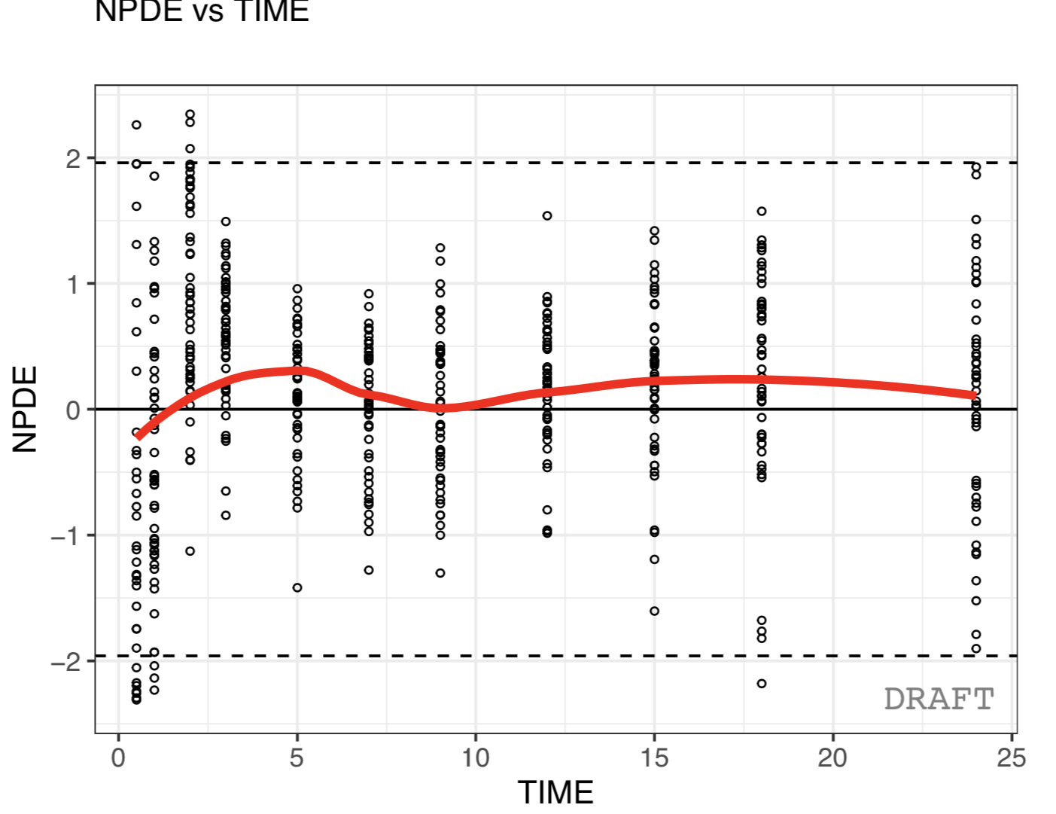
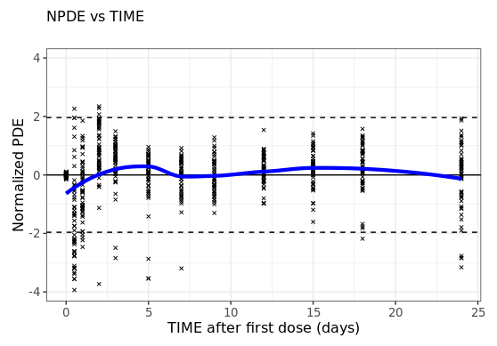
Plots customization – on the fly
Default setting
Updating labels and graphical settings
ctr %>% pmx_plot_npde_time()
ctr %>% pmx_plot_npde_time(
smooth = list(color = "blue"),
point = list(shape = 4),
is.draft = FALSE,
labels = list(x = "TIME after first dose (days)",
y = "Normalized PDE"))
Notes:
IB – The default settings are critical for the success of any package. We made sure that the default setting is good enough, but if you’re not happy with the them, you have the possibility to customize the figures yourself, in a similar way as you would go with ggplot. On the lefthand side, you have the default call to the npde vs time graph. On the right, you have the graph where we changed a few graphical parameters.

Slide 19
Plots customization – globally
Create a “settings” object using pmx_settings(). This object is passed to pmx() as argument “settings”
Using such a syntax is useful when same setting is applied to all plots, e.g.:
Remove DRAFT label (printed by default)
Use meaningful labels, such as “Male” and “Female” instead of 0 or 1
Etc...
theoph_path <- file.path(system.file(package = "ggPMX"), "testdata", "theophylline")
WORK_DIR <- file.path(theoph_path, "Monolix")
input_file <- file.path(theoph_path, "data_pk.csv")
vpc_file <- file.path(theoph_path, "sim.csv")
my_settings = pmx_settings( use.labels = TRUE,
is.draft = FALSE,
cats.labels=list( SEX =c("0"="Male","1"="Female"),
STUD =c("1"="Study 1", "2"="Study 2")))
ctr <- pmx_nlmxir(..., settings = my_settings)
Global settings

Slide 20
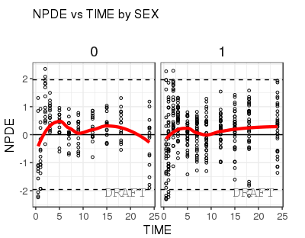
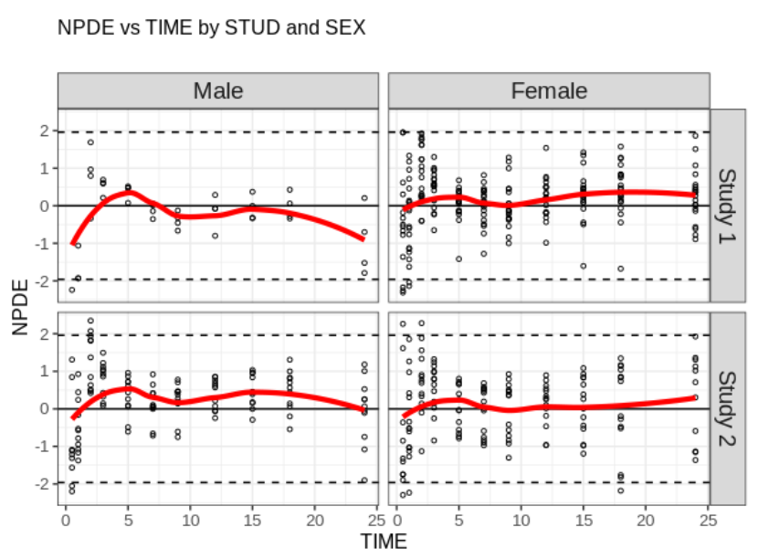
Stratification
Two ways of stratifying a plot:
1. using the stratification function by categorical covariates and providing the plot name in argument:
2. using arguments strat.facet (discrete) or strat.color (continuous) in pmx_plot_xxx(). Allows two-dimentional stratification:
pmx_plot_cats(ctr, "npde_time")
pmx_plot_npde_time(ctr,
strat.facet = STUD~SEX)

Slide 21
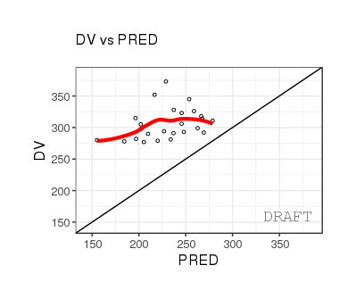
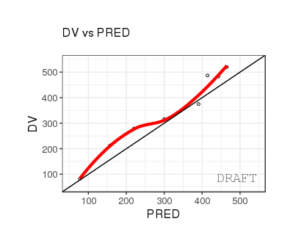
Filtering
Two ways of filtering the data:
Locally, at the level of a plot:
Globally, at the level of the Controller, affecting all subsequent plots:
ctr %>% pmx_plot_dv_pred(filter = DV > mean(DV) & PRED < median(PRED))
ctr %>% pmx_filter(data_set = "prediction",ID == 5 & TIME > 2)
ctr %>% pmx_plot_dv_pred

Slide 22
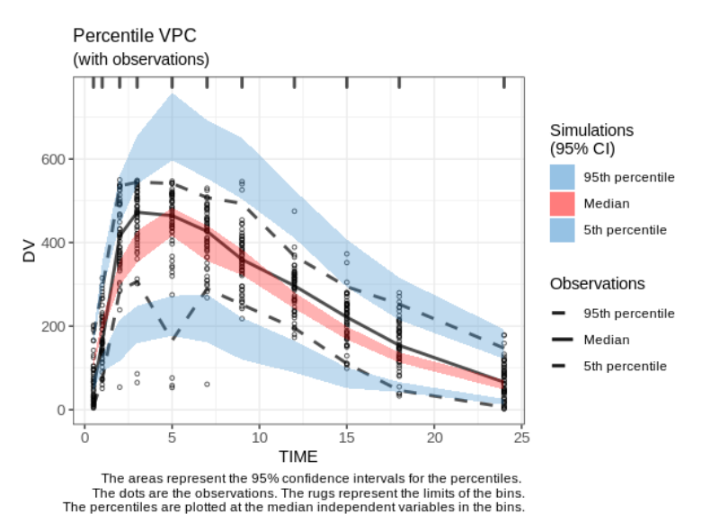
VPC: Default setting
ctr %>% pmx_plot_vpc()
User must provide simulation file (except for nlmixr)
Legend automatically updated when statistical summaries are changed
Bins indicated by ticks on the top x-axis
Various binning methods available (kmeans, jenks, pretty)
Notes:
IB (BB?) – We have implemented the VPC.
We made sure that the VPC figure is self-explanatory by adding a title, legend and footnote. They are all adjusted automatically: whenever you change some of the VPC settings, the legend, title and footnote adjusts automatically. For example, .... We also display the bins.

Slide 23
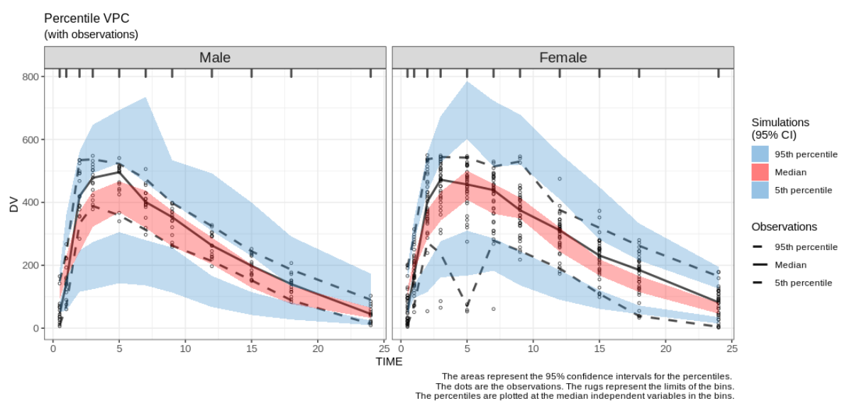
VPC: stratification
ctr %>% pmx_plot_vpc(strat.facet="SEX", facets=list(ncol=2))
Notes:
BB – Like in any figure, you have the possibility to stratify. As expected for VPC, stats will be performed according to the strata!

Slide 24
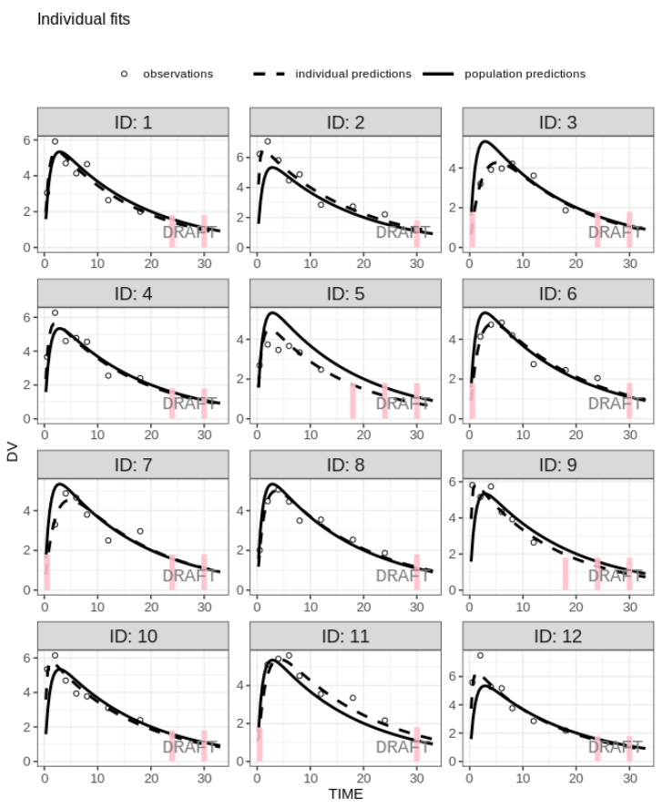
Censored data
Create controller with BLOQ* data (BLQ column in input dataset):
ctr <- pmx_mlxtran(
file_name=mlx_file,
bloq = pmx_bloq(cens = "BLQ"))
ctr %>% pmx_plot_individual()
Works similarly with ULOQ** data.
*BLOQ: below limit of quantification
**ULOQ: upper limit of quantification
Notes:
IB – range of censored data, as in Monolix and it will apply to all individual plots no matter the software.
Will also apply to other GoFs.

Slide 25
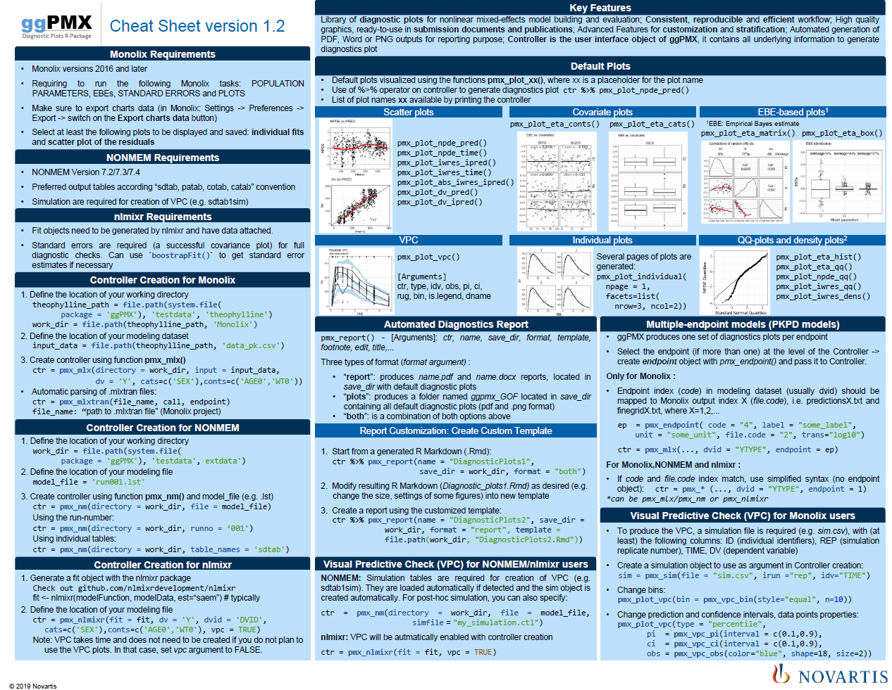
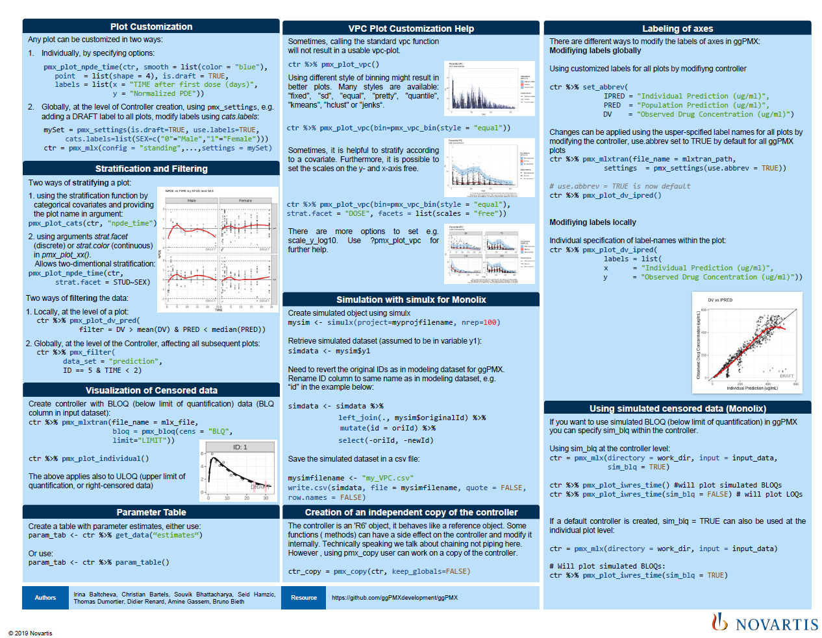
Cheat Sheet
Notes:
BB– Like in any R package that comes from Rstudio, we put a lot of effort in creating 2 pages Cheatsheet that captures the key features of the package. It means that as a new user of the package, and having the cheat sheet on your side, you will be able to use straightforward the package

Slide 26

Documentation & Help
Version available on GitHub and CRAN
Documentation & Training Material on Github
https://github.com/ggPMXdevelopment/ggPMX
Cheat Sheet
Vignette (User Guide)
Notes:
IB+BB
Comprehensive vignette

Slide 28
Backup

Slide 29
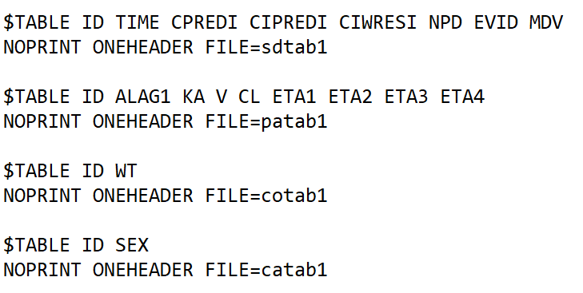
NONMEM requirements for ggPMX
NONMEM versions 7.2 and later
It’s recommended to name output tables according “sdtab, patab, cotab, catab” naming convention with a run number in the end (as for e.g. in xpose).
Example:
Run number can also be a string:
e.g. «model3» → «sdtabmodel3»

Slide 30
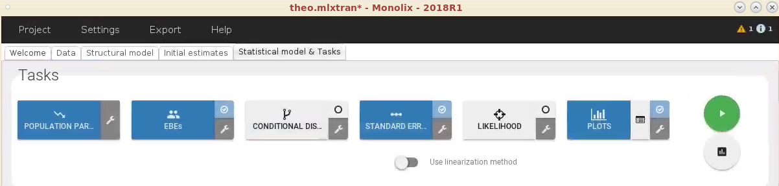
Monolix requirements to obtain all available diagnostic plots (1/3)
Monolix versions 2016 and later
Run at least the following Monolix tasks:
POPULATION PARAMETERS
EBEs
STANDARD ERRORS
PLOTS

Slide 31
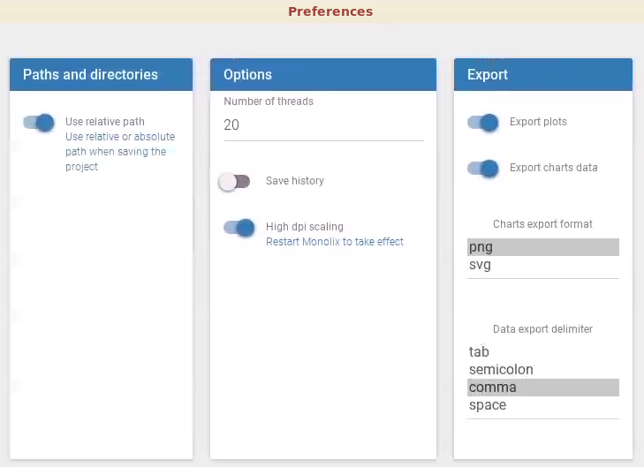
Monolix requirements to obtain all available diagnostic plots (2/3)
Make sure to export charts data
Settings -> Preferences -> Export -> switch on the Export charts data button

Slide 32
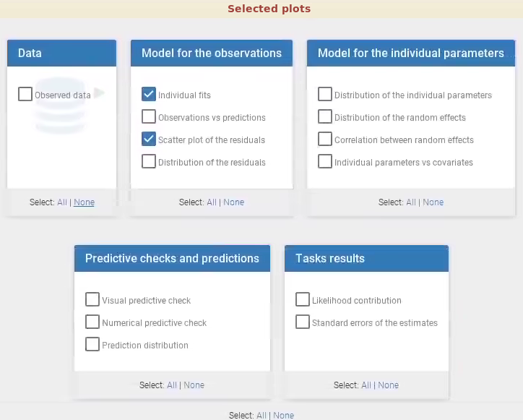
Monolix requirements to obtain all available diagnostic plots (3/3)
Select at least the following plots to be displayed and saved:
individual fits and
scatter plot of the residuals
If some Monolix output files are missing, ggPMX produces a warning and the corresponding plot won’t be available in the Controller.

Slide 33
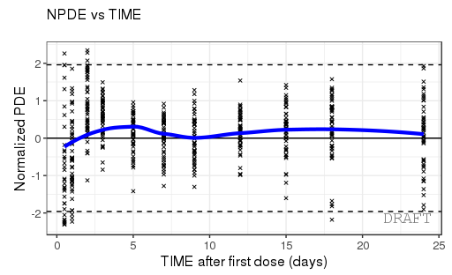
How to customize a plot globally?
Plot Customization
Any plot can be customized in two ways:
Individually, by specifying options:
pmx_plot_npde_time(ctr, smooth = list(color = "blue"),
point = list(shape = 4), is.draft = TRUE,
labels = list(x = "TIME after first dose (days)",
y = "Normalized PDE"))
Globally, at the level of Controller creation, using pmx_settings, e.g. adding a DRAFT label to all plots, modify labels using cats.labels:
mySet = pmx_settings(is.draft=TRUE, use.labels=TRUE,
cats.labels=list(SEX=c("0"="Male","1"="Female")))
ctr = pmx_mlx(config = "standing",...,settings = mySet)

Slide 34
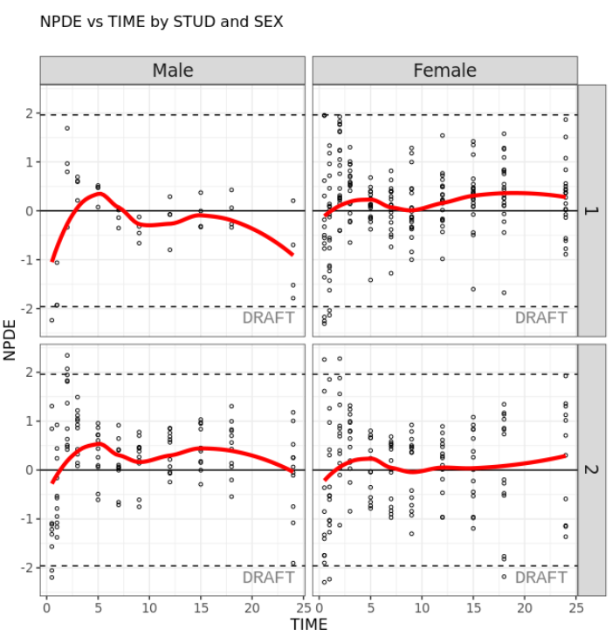
How to filter data?
Stratification and Filtering
Two ways of stratifying a plot:
1. using the stratification function by categorical covariates and providing the plot name in argument:
pmx_plot_cats(ctr, "npde_time")
2. using arguments strat.facet (discrete) or strat.color (continuous) in pmx_plot_xx().
Allows two-dimentional stratification:
pmx_plot_npde_time(ctr,
strat.facet = STUD~SEX)
Two ways of filtering the data:
1. Locally, at the level of a plot:
ctr %>% pmx_plot_dv_pred(
filter = DV > mean(DV) & PRED < median(PRED))
2. Globally, at the level of the Controller, affecting all subsequent plots:
ctr %>% pmx_filter(
data_set = "prediction",
ID == 5 & TIME < 2)

Slide 35
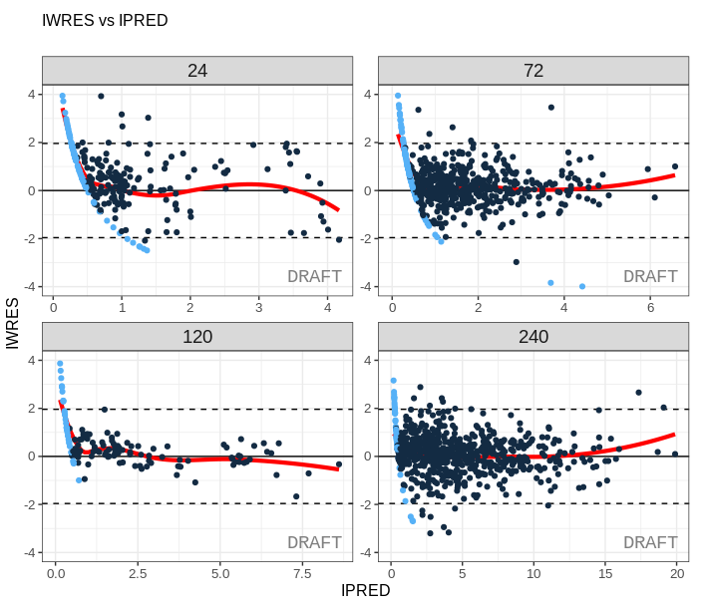
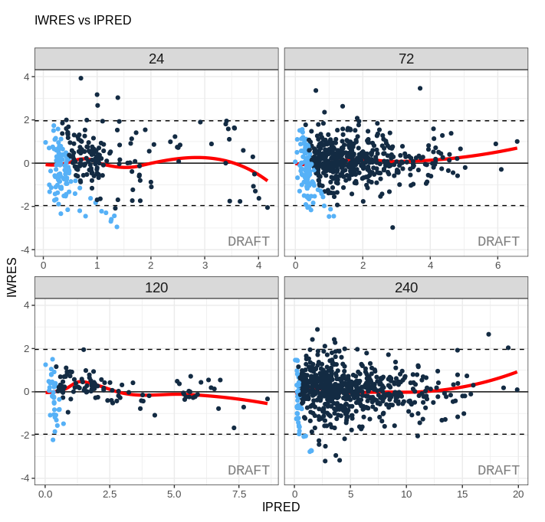
How to use simulated censored data as in Monolix?
Without sim_blq
Using simulated censored data (Monolix)
If you want to use simulated BLOQ (below limit of quantification) in ggPMX you can specify sim_blq within the controller.
Using sim_blq at the controller level:
ctr = pmx_mlx(directory = work_dir, input = input_data,
sim_blq = TRUE)
ctr %>% pmx_plot_iwres_time() #will plot simulated BLOQs
ctr %>% pmx_plot_iwres_time(sim_blq = FALSE) # will plot LOQs
If a default controller is created, sim_blq = TRUE can also be used at the individual plot level:
ctr = pmx_mlx(directory = work_dir, input = input_data)
# Will plot simulated BLOQs:
ctr %>% pmx_plot_iwres_time(sim_blq = TRUE)
With sim_blq

Slide 36
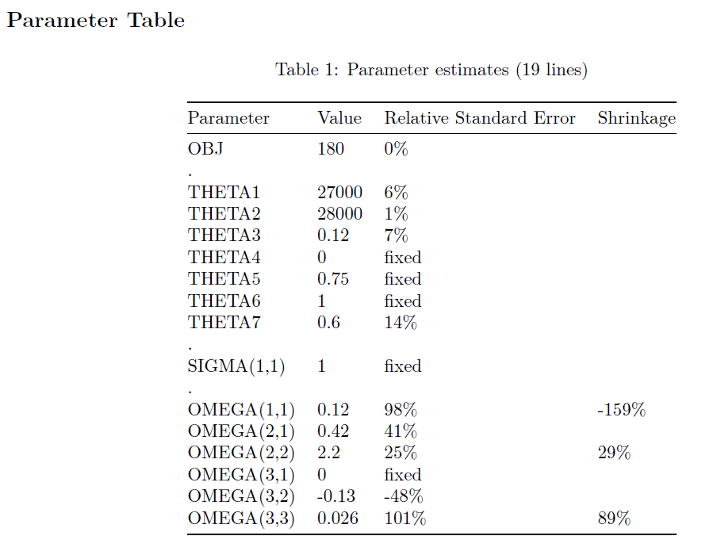
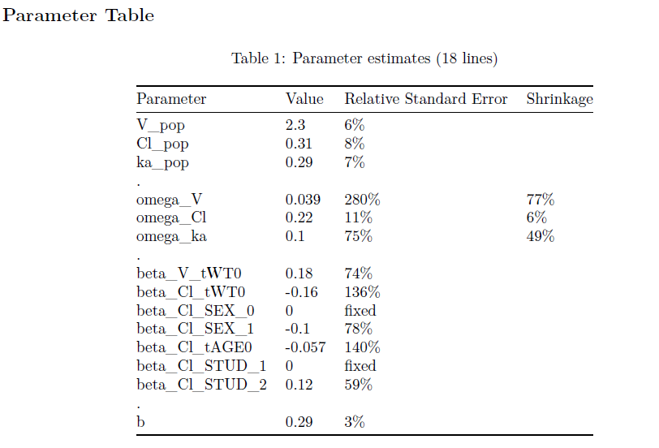
How to display a parameter table?
Parameter Table
Create a table with parameter estimates, either use:
param_tab <- ctr %>% get_data("estimates")
Or use:
param_tab <- ctr %>% param_table()
NONMEM
Monolix
nlmixr

Slide 37
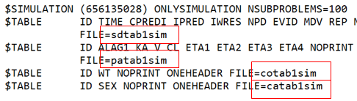
How to create VPC?
NONMEM
Simulation tables are required for creation of VPC (e.g. sdtab1sim). They are loaded automatically if detected and the sim object is created automatically. For post-hoc simulation, you can also specify:
ctr = pmx_nm(directory = work_dir,
file = model_file,
simfile = "my_simulation.ctl")
Example:
Monolix
To produce the VPC, a simulation file is required (e.g. sim.csv), with (at least) the following columns: ID (individual identifiers), REP (simulation replicate number), TIME, DV (dependent variable)
Create a simulation object to use as argument in controller creation:
sim = pmx_sim(file = "sim.csv", irun ="rep", idv="TIME")
Change bins:
pmx_plot_vpc(bin = pmx_vpc_bin(style="equal", n=10))
Change prediction and confidence intervals, data points properties:
pmx_plot_vpc(type = "percentile",
pi = pmx_vpc_pi(interval = c(0.1,0.9), ci = pmx_vpc_ci(interval = c(0.1,0.9),
obs = pmx_vpc_obs(color="blue", shape=18, size=2))
nlmixr
VPC will be autmatically enabled with controller creation
ctr = pmx_nlmixr(fit = fit, vpc = TRUE)

Slide 38
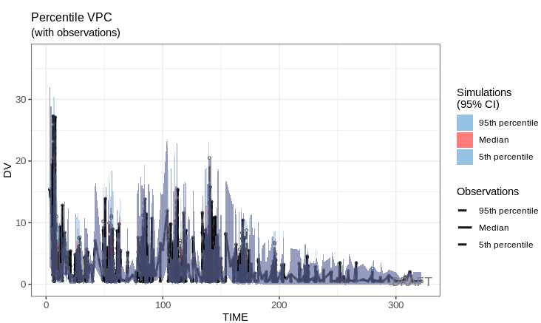
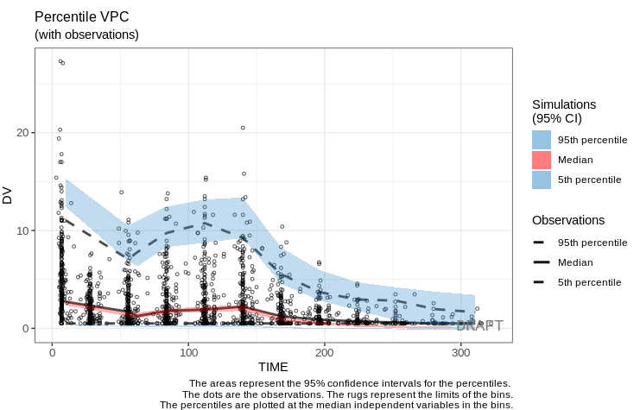
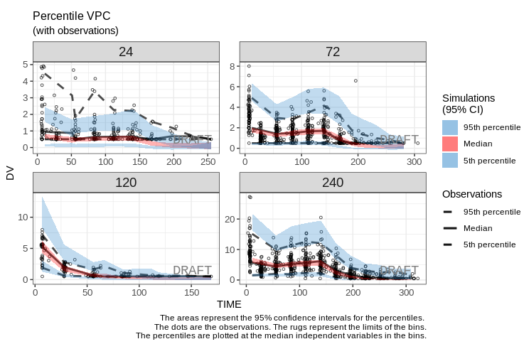
How to customize VPC?
VPC Plot Customization Help
Sometimes, calling the standard vpc function will not result in a usable vpc-plot.
ctr %>% pmx_plot_vpc()
Using different style of binning might result in better plots. Many styles are available: "fixed", "sd", "equal", "pretty", "quantile", "kmeans", "hclust" or "jenks“.
Sometimes, it is helpful to stratify according to a covariate. Furthermore, it is possible to set the scales on the y- and x-axis free.
ctr %>% pmx_plot_vpc(bin = pmx_vpc_bin(style = "equal"))
ctr %>% pmx_plot_vpc(bin = pmx_vpc_bin(style = "equal"),
strat.facet = "DOSE",
facets = list(scales = "free"))

